Slide 1
Unit 4
Data Visualization

Slide 2
Why data visualization?
Gain insight into an information space by mapping data onto graphical primitives
Provide qualitative overview of large data sets
Search for patterns, trends, structure, irregularities, relationships among data
Help find interesting regions and suitable parameters for further quantitative analysis
Provide a visual proof of computer representations derived.

Slide 3
Pixel-Oriented Visualization Techniques
A simple way to visualize the value of a dimension is to use a pixel where the color of the pixel reflects the dimension’s value.
For a data set of m dimensions, pixel-oriented techniques create m windows on the screen, one for each dimension.
The m dimension values of a record are mapped to m pixels at the corresponding positions in the windows. The colors of the pixels reflect the corresponding values.
Inside a window, the data values are arranged in some global order shared by all windows.
The global order may be obtained by sorting all data records in a way that’s meaningful for the task at hand.

Slide 4
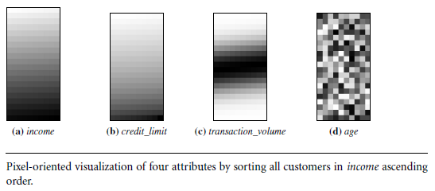
Pixel-oriented visualization
AllElectronics maintains a customer information table, which consists of four dimensions: income, credit limit, transaction volume, and age.
We can sort all customers in income-ascending order, and use this order to lay out the customer data in the four visualization windows.

Slide 5
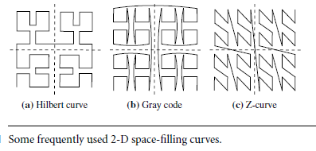
A space-filling curve is a curve with a range that covers the entire n dimensional unit hypercube.
Since the visualization windows are 2-D, we can use any 2-D space-filling curve.

Slide 6
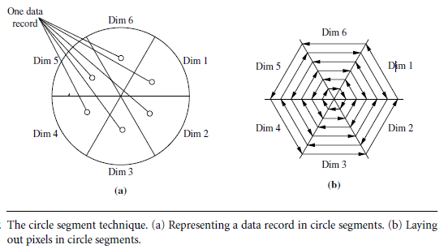
Note that the windows do not have to be rectangular. For example, the circle segment technique uses windows in the shape of segments of a circle.
This technique can ease the comparison of dimensions because the dimension windows are located side by side and form a circle.

Slide 7
Geometric Projection Visualization Techniques
A drawback of pixel-oriented visualization techniques is that they cannot help us much in understanding the distribution of data in a multidimensional space. For example, they do not show whether there is a dense area in a multidimensional subspace.
Geometric projection techniques help users find interesting projections of multidimensional data sets.
The central challenge the geometric projection techniques try to address is how to visualize a high-dimensional space on a 2-D display.
A scatter plot displays 2-D data points using Cartesian coordinates. A third dimension can be added using different colors or shapes to represent different data points.

Slide 8
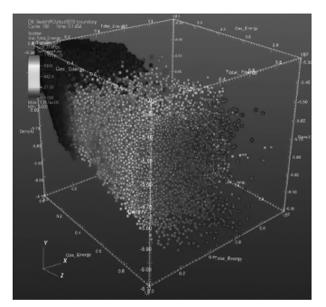
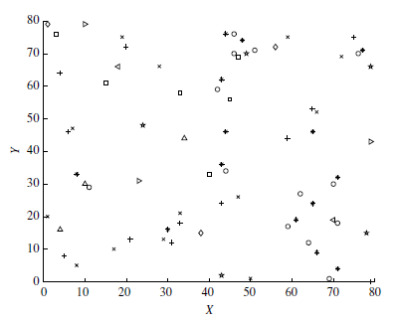
Scatter Plot 2D
Scatter Plot 3D

Slide 9
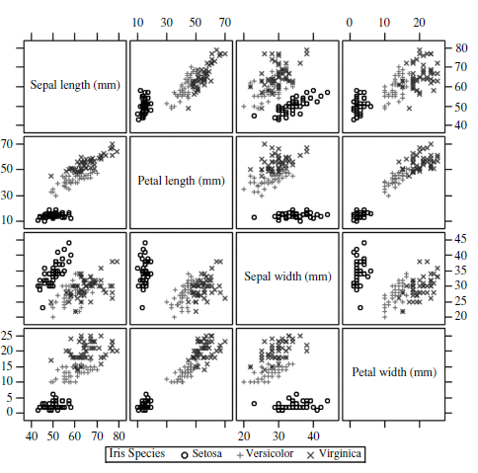
The scatter-plot matrix technique is a useful extension to the scatter plot. For an n dimensional data set, a scatter-plot matrix is an n * n grid of 2-D scatter plots that provides a visualization of each dimension with every other dimension.

Slide 10
To visualize n-dimensional data points, the parallel coordinates technique draws n equally spaced axes, one for each dimension, parallel to one of the display axes.
A data record is represented by a polygonal line that intersects each axis at the point corresponding to the associated dimension value.
A major limitation of the parallel coordinates technique is that it cannot effectively show a data set of many records.
Even for a data set of several thousand records, visual clutter and overlap often reduce the readability of the visualization and make the patterns hard to find.

Slide 11
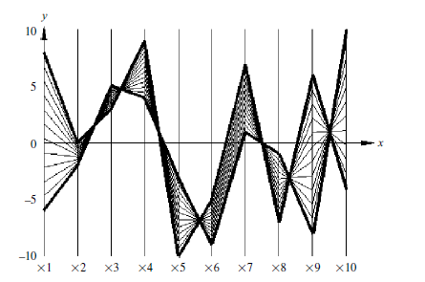
Parallel Coordinates

Slide 12
Icon-Based Visualization Techniques
Icon-based visualization techniques use small icons to represent multidimensional data values. We look at two popular icon-based techniques: Chernoff faces and stick figures.
Chernoff faces were introduced in 1973 by statistician Herman Chernoff. They display multidimensional data of up to 18 variables (or dimensions) as a cartoon human face.
Chernoff faces help reveal trends in the data. Components of the face, such as the eyes, ears, mouth, and nose, represent values of the dimensions by their shape, size, placement, and orientation.
For example, dimensions can be mapped to the following facial characteristics: eye size, eye spacing, nose length, nose width, mouth curvature, mouth width, mouth openness, pupil size, eyebrow slant, eye eccentricity, and head eccentricity.

Slide 13
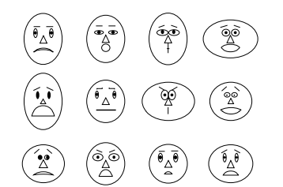
Chernoff Faces

Slide 14
Chernoff faces make use of the ability of the human mind to recognize small differences in facial characteristics and to assimilate many facial characteristics at once.
Chernoff faces make the data easier for users to digest.
In this way, they facilitate visualization of regularities and irregularities present in the data, although their power in relating multiple relationships is limited.
Another limitation is that specific data values are not shown.
Furthermore, facial features vary in perceived importance. This means that the similarity of two faces (representing two multidimensional data points) can vary depending on the order in which dimensions are assigned to facial characteristics. Therefore, this mapping should be carefully chosen.
Eye size and eyebrow slant have been found to be important.

Slide 15
Asymmetrical Chernoff faces were proposed as an extension to the original technique.
Since a face has vertical symmetry (along the y-axis), the left and right side of a face are identical, which wastes space.
Asymmetrical Chernoff faces double the number of facial characteristics, thus allowing up to 36 dimensions to be displayed.
The Stick Figure Visualization Technique maps multidimensional data to five-piece stick figures, where each figure has four limbs and a body.
Two dimensions are mapped to the display (x and y) axes and the remaining dimensions are mapped to the angle and/or length of the limbs.

Slide 16
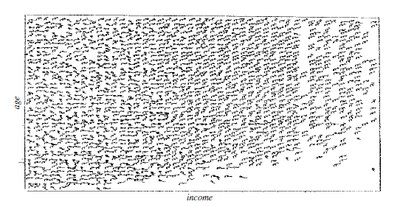
Figure shows census data, where age and income are mapped to the display axes, and the remaining dimensions (gender, education, and so on) are mapped to stick figures. If the data items are relatively dense with respect to the two display dimensions, the resulting visualization shows texture patterns, reflecting data trends.

Slide 17
Hierarchical Visualization Techniques
The visualization techniques discussed so far focus on visualizing multiple dimensions simultaneously.
However, for a large data set of high dimensionality, it would be difficult to visualize all dimensions at the same time.
Hierarchical visualization techniques partition all dimensions into subsets (i.e., subspaces). The subspaces are visualized in a hierarchical manner.
“Worlds-within-Worlds,” also known as n-Vision, is a representative hierarchical visualization method.
Suppose we want to visualize a 6-D data set, where the dimensions are F,X1, : : : ,X5.

Slide 18
We want to observe how dimension F changes with respect to the other dimensions. We can first fix the values of dimensions X3,X4,X5 to some selected values, say, c3, c4, c5.
We can then visualize F,X1,X2 using a 3-D plot, called a world. The position of the origin of the inner world is located at the point .c3, c4, c5 in the outer world, which is another 3-D plot using dimensions X3,X4,X5.
A user can interactively change, in the outer world, the location of the origin of the inner world.
The user then views the resulting changes of the inner world. Moreover, a user can vary the dimensions used in the inner world and the outer world.
Given more dimensions, more levels of worlds can be used, which is why the method is called “worlds-within-worlds.”

Slide 19
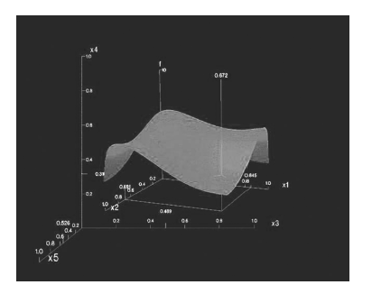
Worlds - Within - Worlds

Slide 20
As another example of hierarchical visualization methods, tree-maps display hierarchical data as a set of nested rectangles.
For example, a tree-map visualizing Google news stories.
All news stories are organized into seven categories, each shown in a large rectangle of a unique color.
Within each category (i.e., each rectangle at the top level), the news stories are further partitioned into smaller subcategories.

Slide 21
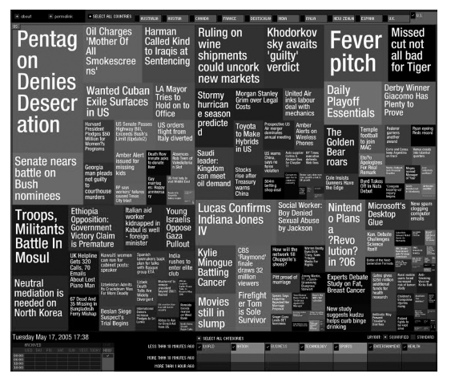
Tree Map

Slide 22
Visualizing Complex Data and Relations
In early days, visualization techniques were mainly for numeric data. Recently, more and more non-numeric data, such as text and social networks, have become available.
Visualizing and analyzing such data attracts a lot of interest.
There are many new visualization techniques dedicated to these kinds of data. For example, many people on the Web tag various objects such as pictures, blog entries, and product reviews.
A tag cloud is a visualization of statistics of user-generated tags.
Often, in a tag cloud, tags are listed alphabetically or in a user-preferred order. The importance of a tag is indicated by font size or color.

Slide 23
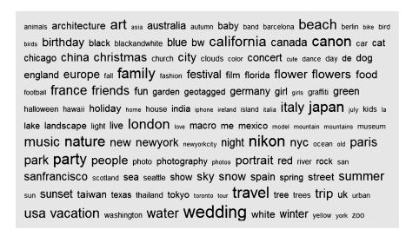
Tag Cloud

Slide 24
Tag clouds are often used in two ways.
First, in a tag cloud for a single item, we can use the size of a tag to represent the number of times that the tag is applied to this item by different users.
Second, when visualizing the tag statistics on multiple items, we can use the size of a tag to represent the number of items that the tag has been applied to, that is, the popularity of the tag.
In addition to complex data, complex relations among data entries also raise challenges for visualization.
For example, the following uses a disease influence graph to visualize the correlations between diseases.
The nodes in the graph are diseases, and the size of each node is proportional to the prevalence of the corresponding disease.

Slide 25
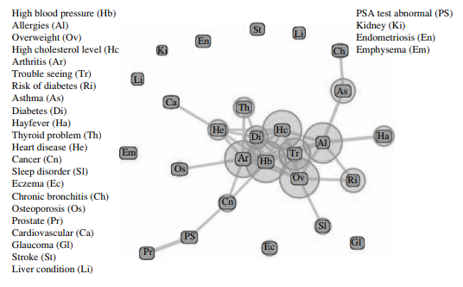
Two nodes are linked by an edge if the corresponding diseases have a strong correlation. The width of an edge is proportional to the strength of the correlation pattern of the two corresponding diseases

Slide 26
Statistical Programming in R
Srinivasa, Siddesh, Shetty & Sowmya

Slide 27
8: Charts and Graphs
Objectives
• Pie chart and 3D pie chart
• Bar chart
• Box plot
• Histogram
• Line graph and multiple line graph
• Scatter plot

Slide 28
8.1 Introduction
Charts are mainly used to generate a graphical representation of the given data sets.
It is a diagrammatical representation of information, in which the information is shown in the form of a circle, bar, line, etc.
It helps the user to understand the information better and make data visualization simpler.

Slide 29
8.2 Pie Chart
Pie charts give more visibility as judging length is more precise than judging volume
Syntax
The general syntax for creating a pie chart using R is as follows:
pie(arguments)
pie (part, labels, edges, radius, clockwise, init.angle, density, angle,col, main)
The following are the arguments:
• part: contains a vector of non-negative numeric values and tells the size of parts
• labels: used to assign names to each part
• edges: used to change the outer circle of the pie; the default value is 200
• radius: used to change the radius of the pie chart circle; the value is between −1 and 1

Slide 30
• clockwise: used to draw chart parts in the clockwise or counterclockwise direction; takes a Boolean value, that is, true or false
• init.angle: used to specify the initial angle (in degrees) for chart parts; the default value is 0
• density: used to show the density of the shading lines inside the chart; the default value is NULL (no shading)
• angle: used to change the angle of the shading lines inside the chart
• col: used to show colors in chart
• main: used to display the title of the chart

Slide 31
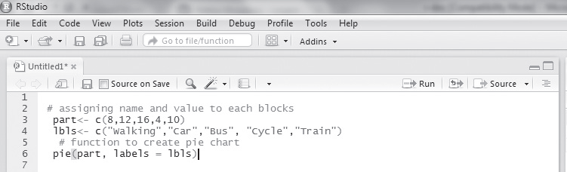
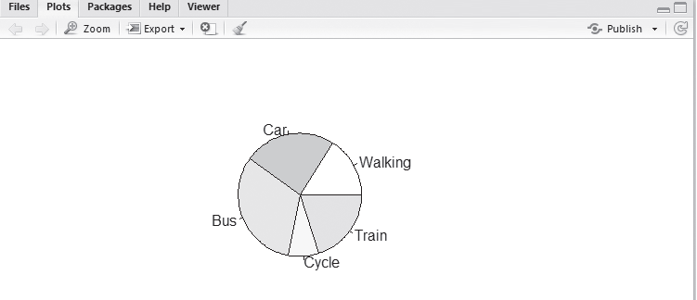
Example:
Using R pie chart, demonstrate the percentage conveyance of various ways for traveling to office such as walking, car, bus, cycle, and train.

Slide 32
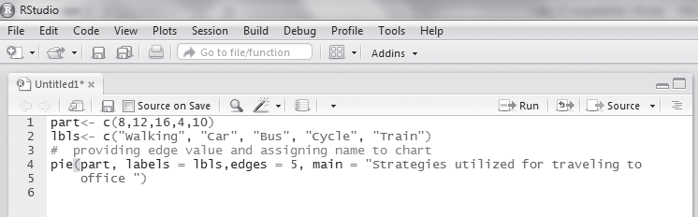
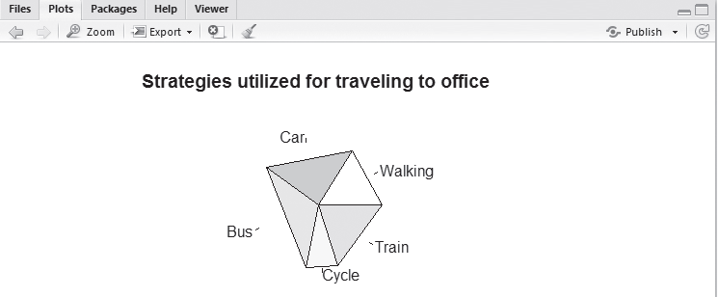
Illustration of Pi()

Slide 33
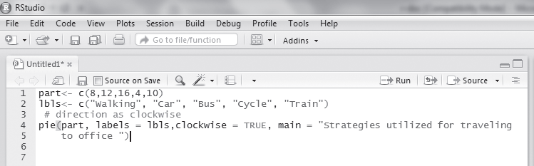
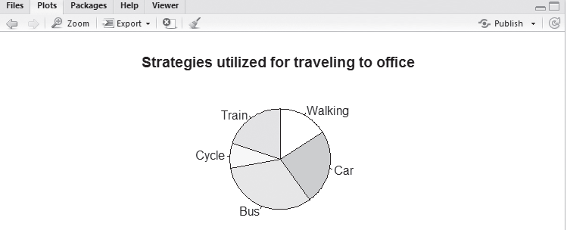
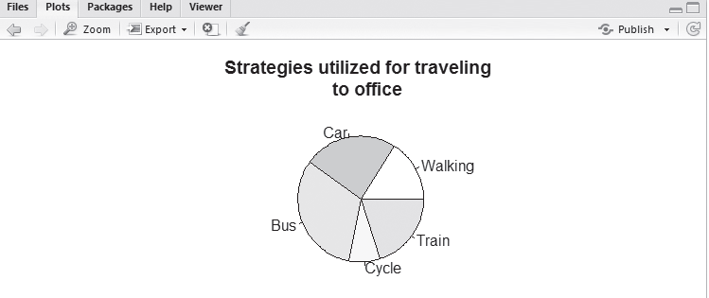
Illustration of Pi()
Commands and output for part, labels, clockwise, and main

Slide 34
8.2.1 Chart Legend
Chart legends are used to provide a small description of each part; we can specify where on the chart it should be displayed, that is, top-left, top-right, bottom-left, or bottom-right, etc. In a pie chart, the legend is included using the legend function
legend (graphics)
Example: legend (position, labels, fill)
Here
• position: states the position of legend
• labels: defines the label of blocks

Slide 35
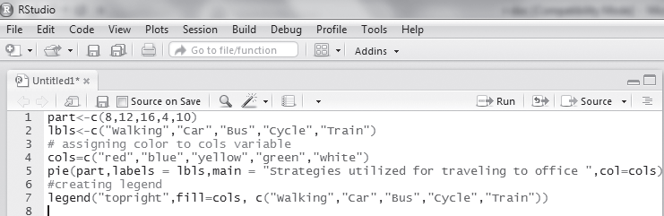
Example
Using a chart legend, show the percentage conveyance of various ways for traveling to office such as walking, car, bus, cycle, and train.
(i) Walking is assigned red color, car – blue color, bus – yellow color, cycle – green color, and train – white color; all these values are assigned through cols and lbls variables and the legend function.
(ii) The fill parameter is used to assign colors to the legend.
(iii) Legend is added to the top-right side of the chart, by assigning

Slide 36
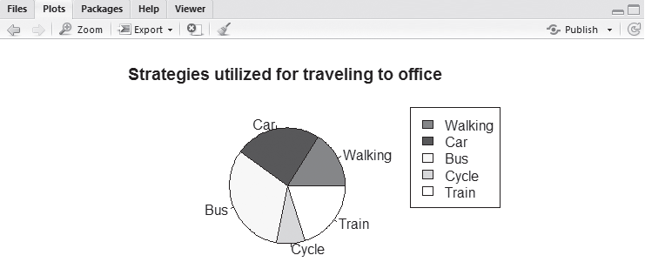
Fig. 8.9 Commands and output for legend

Slide 37
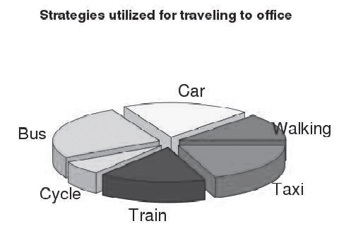
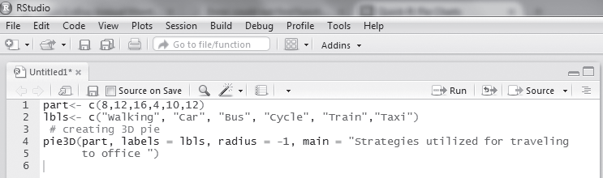
8.2.2 3D Pie Chart
A pie chart of three-dimensional (3D) shape is called a 3D pie chart. It is used to display the information in 3D form.
A 3D pie chart can be created using the pie3D function
Syntax
Pie3D(parameters)

Slide 38
8.3 Bar Chart
A bar chart represents data in rectangular bars with lengths relative to the value.
Syntax
barplot (arguments)
Example:
barplot (part, names.arg, xlab, ylab, main, col)
The following are the most used arguments in real-time:
• part: contains a vector of non-negative numeric values, tells the size of parts
• main: used to display the title of the bar chart
• xlab: used to provide the label for the X-axis
• ylab: used to provide the label for the Y-axis

Slide 39
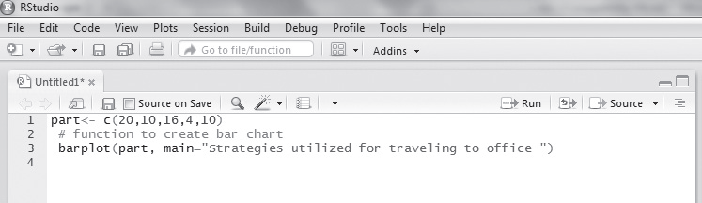
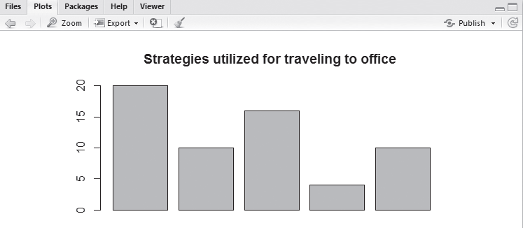
Example
Using R bar chart, demonstrate the percentage conveyance of various strategies utilized for traveling to office such as bike, car, bus, auto, and train.

Slide 40
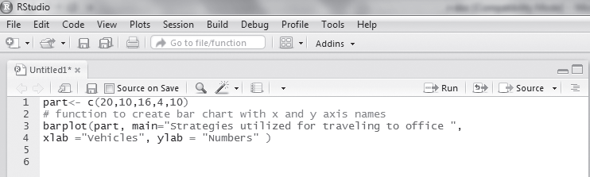
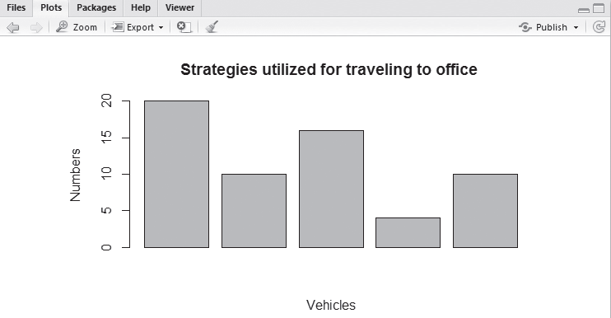
Considering parameters part, main, xlab, and ylab.
(i) Numerical values 8, 12, 16, 4, and 10 are assigned to the part argument.
(ii) The barplot function is used to create a bar chart; here part is used to assign values to each part of the chart and main is used to assign the title ‘Strategies utilized for traveling to office’ for the chart.
(iii) The xlab argument is used to assign the name to x-axis as Vehicles.
(iv) The ylab argument is used to assign the name to y-axis as Numbers
Commands and output for part, main, xlab, and ylab

Slide 41
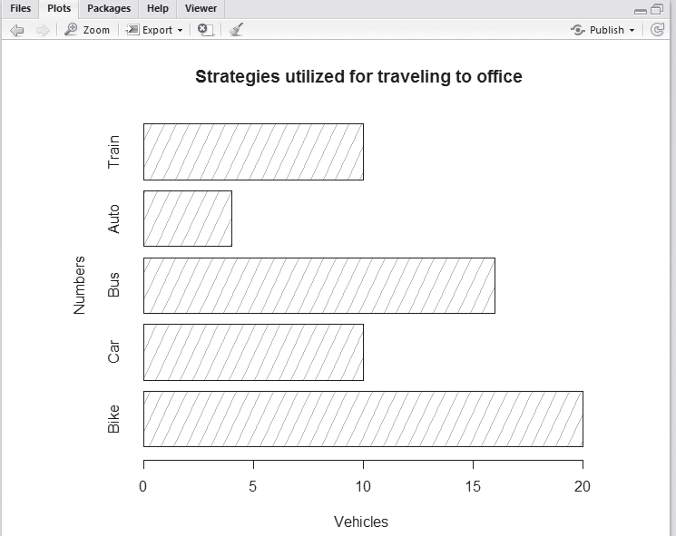
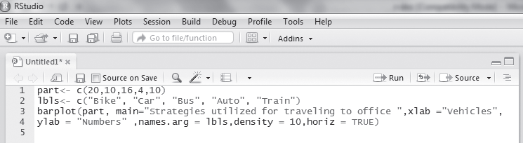
Considering the parameters part, main, xlab, ylab, names.arg, density, and horiz
Commands and output for part, main, xlab, ylab, names.arg, density, and horiz

Slide 42
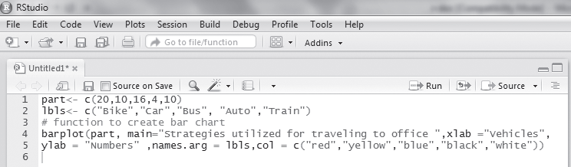
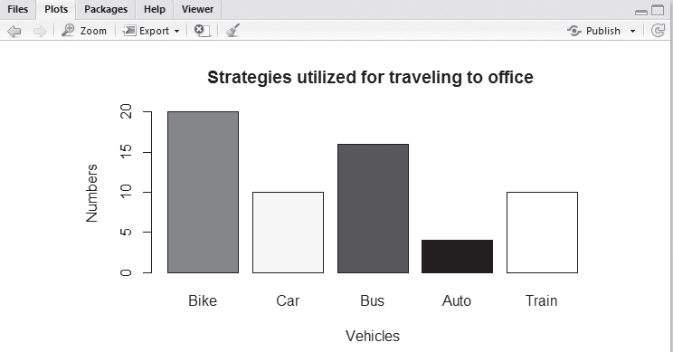
Considering the color parameter

Slide 43
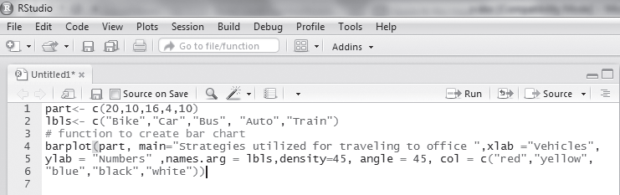
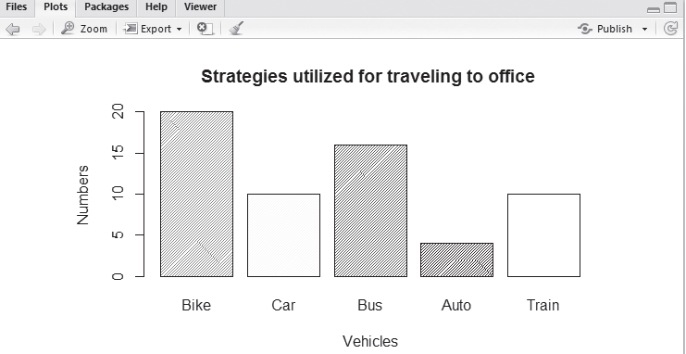
Considering the parameters density, angle, and color

Slide 44
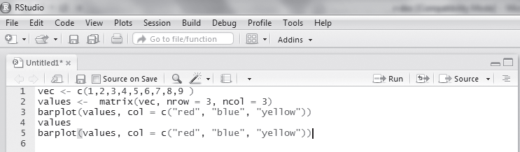
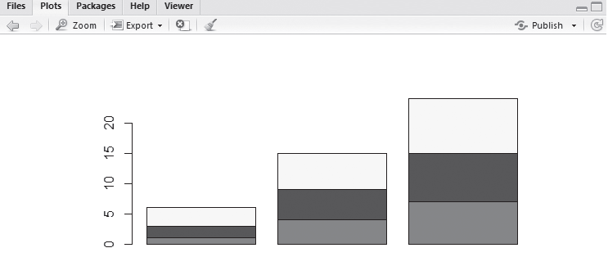
Designing a stacked bar plot using matrix values

Slide 45
8.4 Box Plot
The box plot is a method to graphically picture the numerical information, gathered by p
Syntax
boxplot(arguments)
There are various arguments in boxplot, some of them are as follows:
• data: contains a list of data to design a box plot
• x: data or values to draw the box plot
• xlab: label for x-axis
• ylab: label for y-axis
• main: displays the title for the box plot
• col: used to assign color to the box plot.
• notch: used to design a line on each side of the boxes; takes a Boolean value

Slide 46
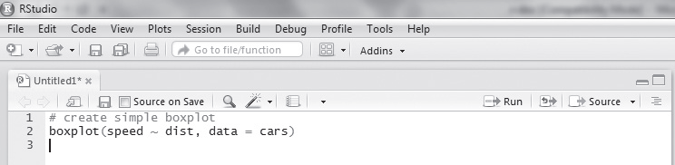
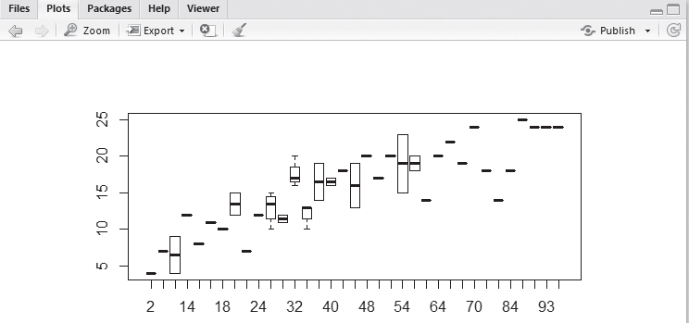
Example
Using box plots demonstrate the relation between the cars speed and the distance taken to stop
Considering the parameters data and x
(i) The boxplot function is used to create a box chart.
(ii) Here we are displaying the speed and dist parameter of Cars data set using x and data parameters
Commands and output for data and x

Slide 47
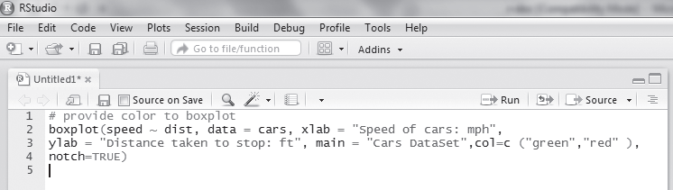
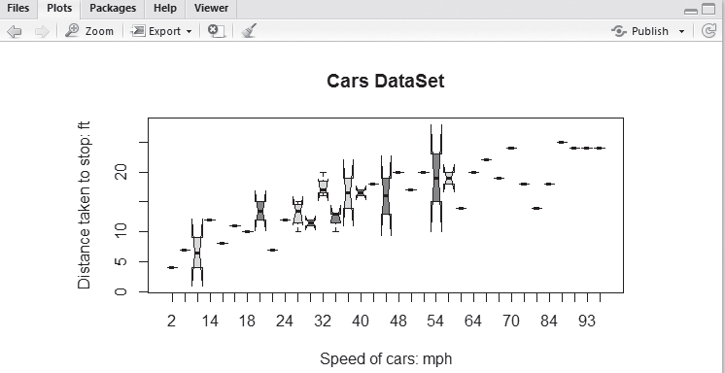

Slide 48
8.5 Histogram
A histogram is a plot that gives us a chance to find, and show, the hidden recurrence (shape) of a set of continuous information
Syntax
hist(arguments)
The following are the list of arguments used:
• data: values to create a histogram
• main: title of the histogram
• col: provides color for blocks
• xlab: label for x-axis
• ylab: label for y-axis
• labels: used to display the values of the blocks at the top; takes a Boolean value
• xlim: used to display values till a specific limit on the x-axis; takes (x1, x2) as input value where x1
and x2 are numbers set of continuous information

Slide 49
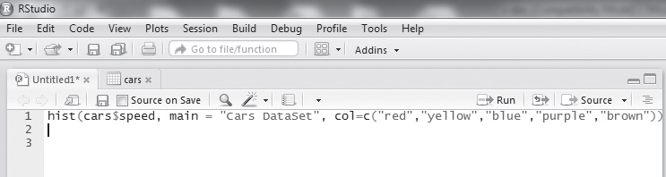
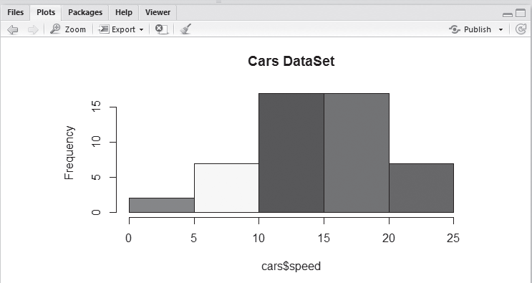
Example
Using R histogram, demonstrate the relationship between the cars speed and distance taken to stop.
Commands and output for data, main, and col

Slide 50
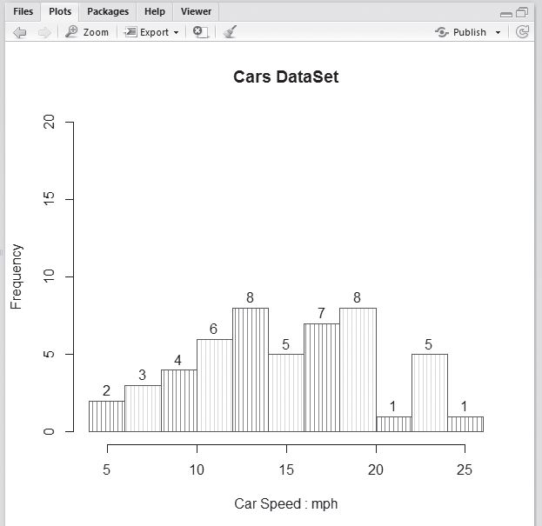
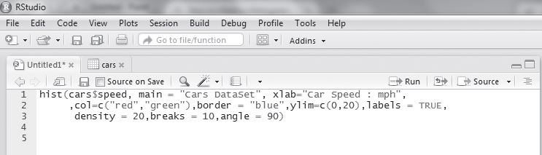
Illustration of Histogram
Considering the parameters density, break, and angle
(i) The value of density is passed as 20; this will create multiple lines inside each block.
(ii) The angle parameter is used to give a particular angle to the vertical lines that are present inside each block; here, angle = 90° will create each line in 90° angle form.

Slide 51
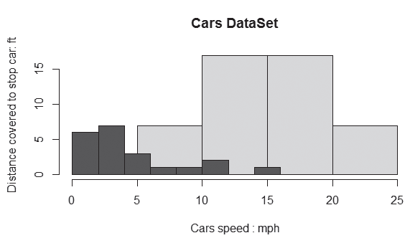
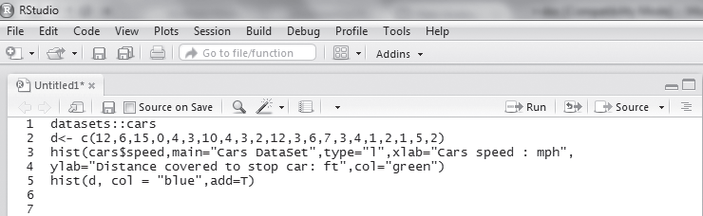
Illustration of Histogram
Combining multiple histograms
(i) Two different histograms are combined by taking values of the inbuilt data set of R Studio, that is, cars, and in the next one we are assigning a value to the variable d.
(ii) Two different function are called to create histograms—one for the cars data set and another one for d variable values.
Commands and output for multiple histograms

Slide 52
8.6 Line Graph
A line graph is a kind of graph used to show information as a sequence of data, which are linked thr
Syntax
plot(arguments)
The following are the list of arguments used:
• data: numeric values, used to create the graph
• type: used to show lines in different forms, as follows:
l: show only line
p: show only points
o: show both points and line
h: show line in vertical format

Slide 53
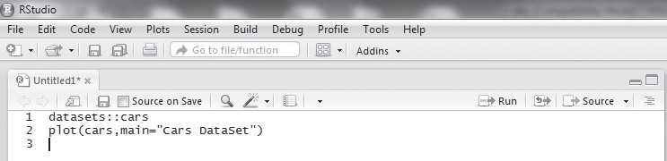
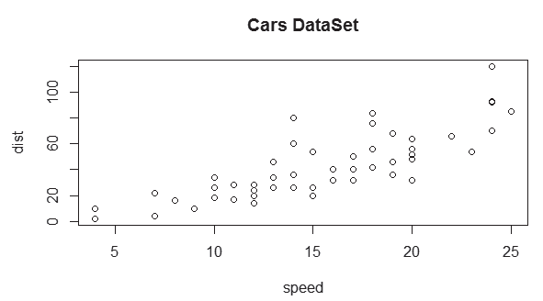
Example
Using R line graphs, demonstrate the relationship between cars speed and the distance taken to stop.

Slide 54
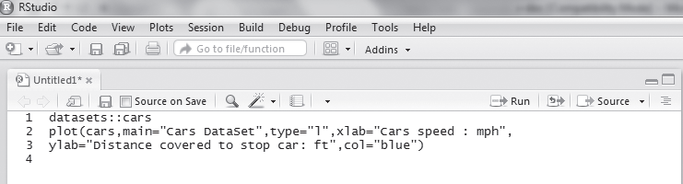
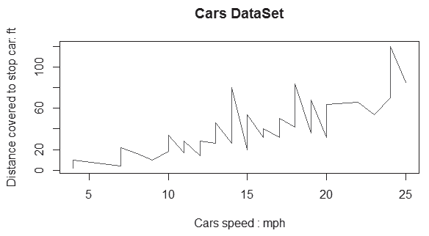
Illustration of Line graph
Considering the parameters data, type = l, col, main, xlab, and ylab

Slide 55


8.6.1 Multiple Lines in Line Graph
Commands and output for multiple lines

Slide 56
8.7 Scatter Plot
Scatter plots are used to show the relation between two variables of the given sets of data.
Syntax
Plot(arguments)
The following are some of the arguments used:
• x: data for x-axis
• y: data for y-axis
• main: title of the scatter plot
• type: can take the following values:
p: to show values as points
l: to show values as a line
h: to generate a histogram

Slide 57


Example
Using scatter plots in R, demonstrate the relationship between cars speed and the distance taken to stop it.
Considering the parameters x, y, sub, and main

Slide 58



Slide 59
THANK YOU

